Slide 1

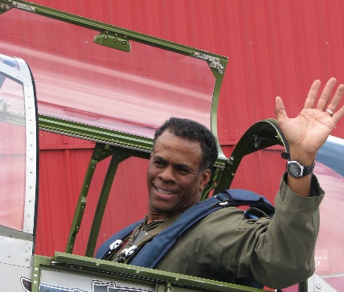
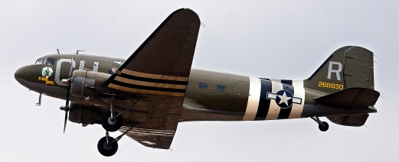
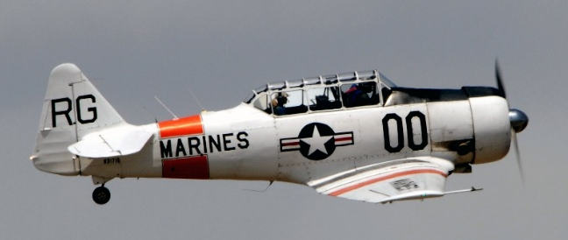

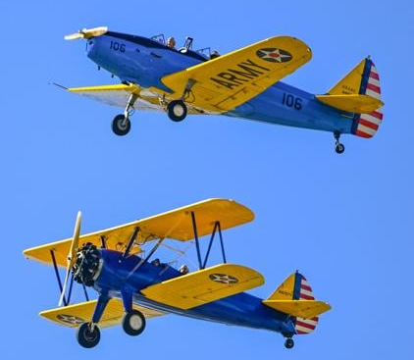
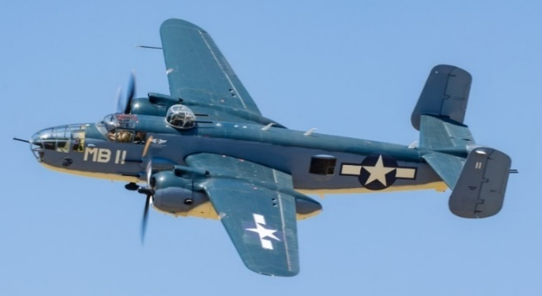
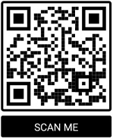


Torrance Armed Forces Day Ramp Review
20 May 2023 10 AM – 3 PM
Join us for the 61st Torrance Armed Forces Day Parade Flight Line Activities
Your $5 admission fee will give you the opportunity to meet the pilots who fly these warbirds, ask questions, and witness the warbirds taxi out, line up in sequence and launch to fly over the parade starting at 1:15 PM.
Thank You Jersey Mike’s Subs South Bay & Los Angeles
Thank You Torrance Doubletree Hotel
Museum Members Free
Non-Members: $5
Free Parking Available in
Museum Lot
3315 Airport Drive
Torrance, CA 90505
(310) 326-9544
www.wmof.com

