Slide 1
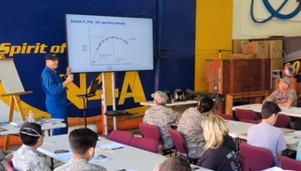
FLIGHT TEST DAY CAMP
JULY 11, 2024
9:00 AM – 2:00 PM
Derived from the National Test Pilot School, this course consists of an immersive day including: exploring military and prototype fighter jets in person and watching real flight test footage. Students will sit in the cockpit of a supersonic fighter jet to understand combat missions. Join us to learn about a career in flight test.
COL. ROY MARTIN
USAF (ret)
Graduate, US Air Force Test Pilot School at Edwards Air Force Base
200+ USAF missions
flown 1972 - 1973
Qualified on 70+ types of aircraft
Northrop Grumman test pilot
FEE: $30 PER STUDENT
SIGN UP AT INFO@WMOF.COM
Ideal for 13 Yrs and Up
Water & Snacks Provided
Bring Your Own Lunch
3315 AIRPORT DRIVE
TORRANCE, CA 90505
(310) 326-9544
WWW.WMOF.COM
Learn about:
Principles of Flight
Types and characteristics of aircraft
Aircraft structures and propulsion
Design decision criteria
Standard and special flight procedures
FREE PARKING Available in Museum Lot
FIND US ON YOUTUBE

