Slide 1

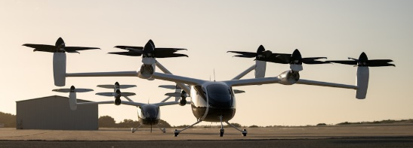



Celebrity Lecture Series
The Two “Jackies”
Jacqueline Cochran, Jacqueline Auriol
The World’s First Supersonic Women
July 20, 2024
11 AM Lecture
Lynn Jenson
Northrop Grumman Project Manager
Former Western Museum of Flight Curator
The two Jacquie’s, Cochran and Auriol, always competing to set new records and doing so very successfully. The seesaw competition for these two women to set new aviation records led them to accomplish truly extraordinary things. Ultimately, they both achieved the rate goal of exceeding the speed of sound when this feat had been accomplished by very few.
Join us to hear aviation history expert, Lynn Jenson, who will describe for us the lives and achievements of these two remarkable women.
Coming August 17
The Electric Road Goes Airborne
Joby Aviation
Electric Aerial Ridesharing
Sponsored by
Museum Members Free
Non-Members: $15
Free Parking Available in
Museum Lot
Find Us
On YouTube
3315 Airport Drive
Torrance, CA 90505
(310) 326-9544
www.wmof.com

