Slide 1


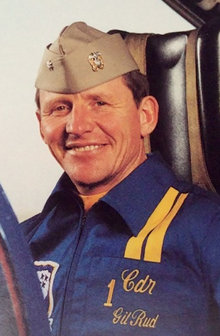
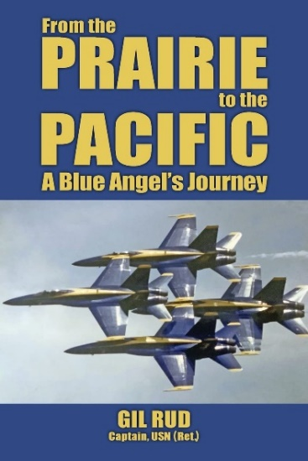
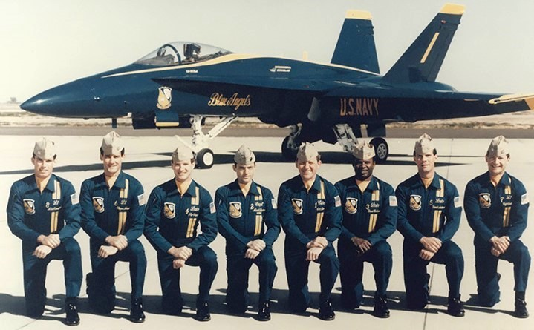



Celebrity Lecture Series
Skyhawk to Hornet
Blue Angels Flight Leader
16 November 2024
11 AM Lecture
Blue Angels flight leader, Captain Gil Rud, takes us for a demo flight to transition the team from the A-4 Skyhawk to the F/A-18 Hornet. Veteran Navy pilot and former Captain of the Aircraft Carrier Constellation, shares with us his career in the Tailhook Navy.
Gil Rud, Captain
USN (ret)
Cpt Rud’s book Available on Amazon
Sponsored by
Museum Members Free
Non-Members: $15
Free Parking Available in
Museum Lot
Find Us
On YouTube
3315 Airport Drive
Torrance, CA 90505
(310) 326-9544
www.wmof.com

