Slide 1

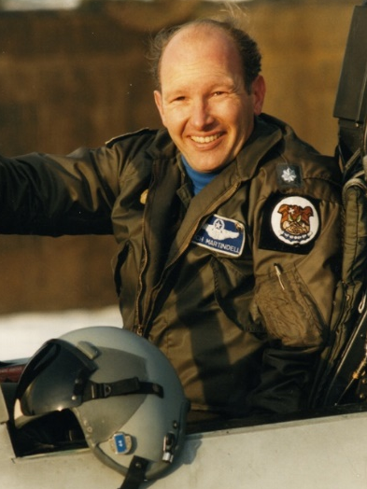
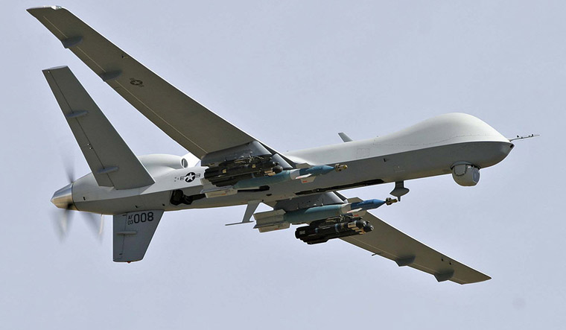
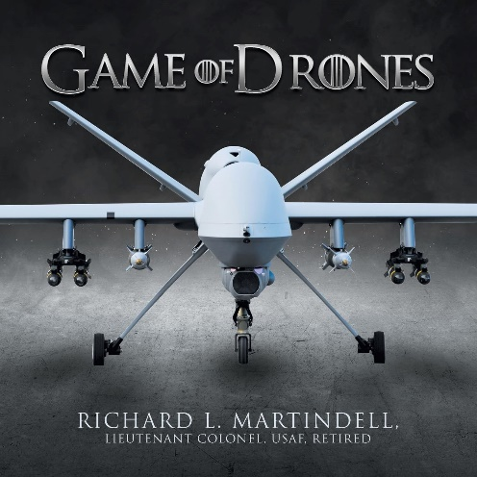



Celebrity Lecture Series
Warfare at Arms Length
15 February 2025
11 AM Lecture
Saga of Flying the General Atomics MQ-9 Combat Drone
Richard L. Martindell
USAF Lt Col (Ret)
Air Force Fighter Pilot, Richard Martindell, compares flying manned aircraft and unmanned in combat. The operational environments: what life is like in the cockpit and at the control console. Please join us.
Books Available for Purchase and Signature
Sponsored by
Museum Members Free
Non-Members: $15
Free Parking Available in
Museum Lot
Find Us
On YouTube
3315 Airport Drive
Torrance, CA 90505
(310) 326-9544
www.wmof.com

