Slide 1

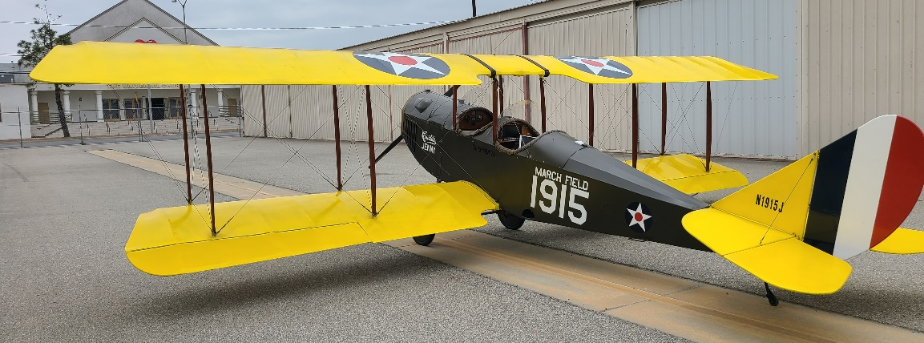
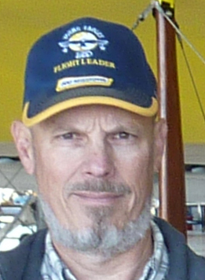
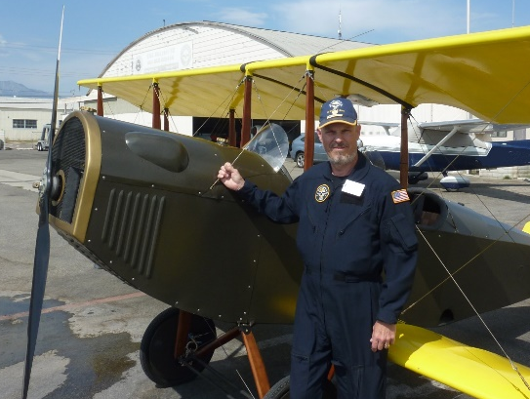



Celebrity Lecture Series
The Jovial Jenny
August 16, 2025
11 AM Lecture
The Curtiss Jenny had all the characteristics of the ideal trainer aircraft. It was reliable, forgiving, and easy to fly. Because of this, combined with its relative ease of construction, the Jenny became the standard trainer for US military pilots during WW I, and for many years afterward. Please join us to see a realistic, flying replica of this aviation icon, built by Rhon Williams and his team of enthusiasts from the Experimental Aircraft Association. The aircraft and its builder/pilot will be on-hand to reveal the flying characteristics of the beloved airplane that gave thousands of pilots their start in the world of aviation, as well as present the details of his 13-year complex journey building this 2/3 scale Early Bird Curtiss Jenny biplane from scratch.
Rhon Williams
Rhon’s Jenny will be on display for the lecture
Sponsored by
Museum Members Free
Non-Members: $15
Free Parking Available in
Museum Lot
Find Us
On YouTube
3315 Airport Drive
Torrance, CA 90505
(310) 326-9544
www.wmof.com

