Slide 1



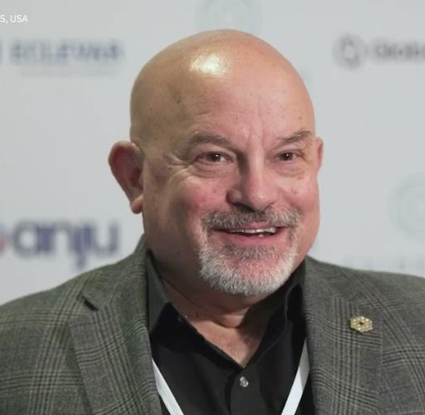
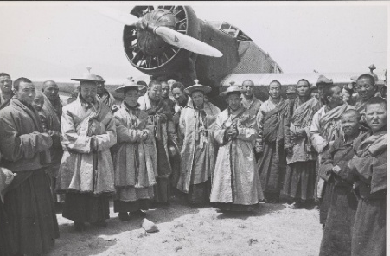
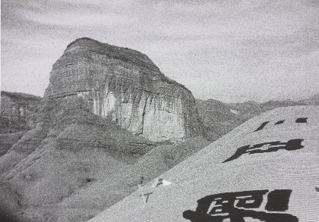
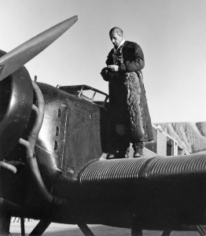



Celebrity Lecture Series
German Aviation in China’s Middle Kingdom
21 February 2026
11 AM Lecture
Thomas H. Hahn Ph.D.
UC Berkeley
Professor Hahn will share the photographic legacy of pioneering German aviator, Captain Hans Koester. This is a rare historical perspective on China from the air during the 1930’s and 1940’s with a focus on the development of airfields, airlines, and the transfer of aviation technology from Germany to China.
21 March 2026
Dr. Jon Arenberg
Northrop Grumman Fellow and Chief Mission Architect for Science and Robotic Exploration will provide a fascinating look at “Inventing Tomorrow: Imagining the Space Observatories of the Future”.
Sponsored by
Museum Members Free
Non-Members: $15
Free Parking Available in
Museum Lot
Find Us
On YouTube
3315 Airport Drive
Torrance, CA 90505
(310) 326-9544
www.wmof.com

